Slide 1


Welcome to

Slide 2



CONTENT
History |  |  | Airport
Currency |  |  | Nationals of Iceland
Culture |  |  | Import & Export
Food |  |  | Tourist place

Slide 3


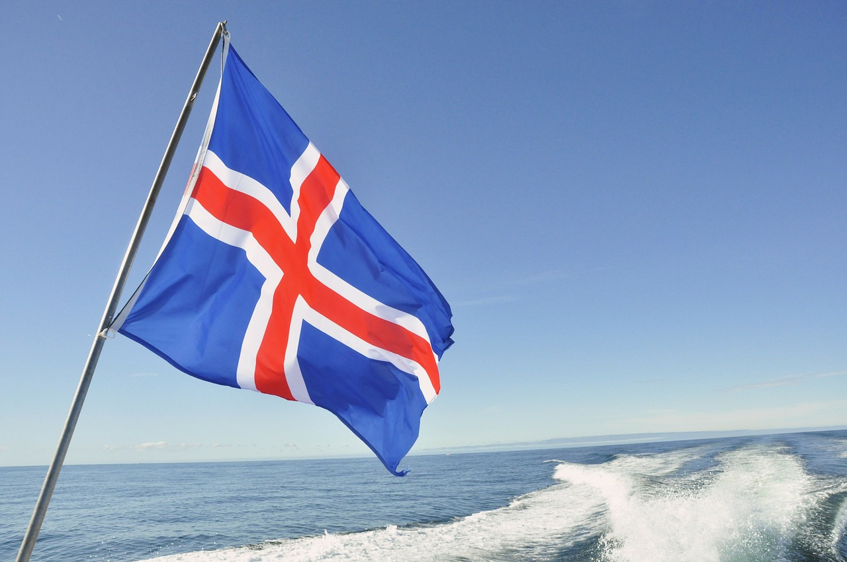
ABOUT
Iceland capital in Reykjavik
Airportcode-RKV
Iceland president Guani Th.johannessan

Slide 4

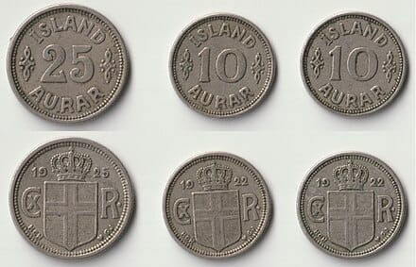

CURRENCY
The name krona come from the Latin word
1 Icelandic krona = 0.60 Indian rupee
Iceland first coins were 10 and 25 aurar pieces introduced in 1992

Slide 5

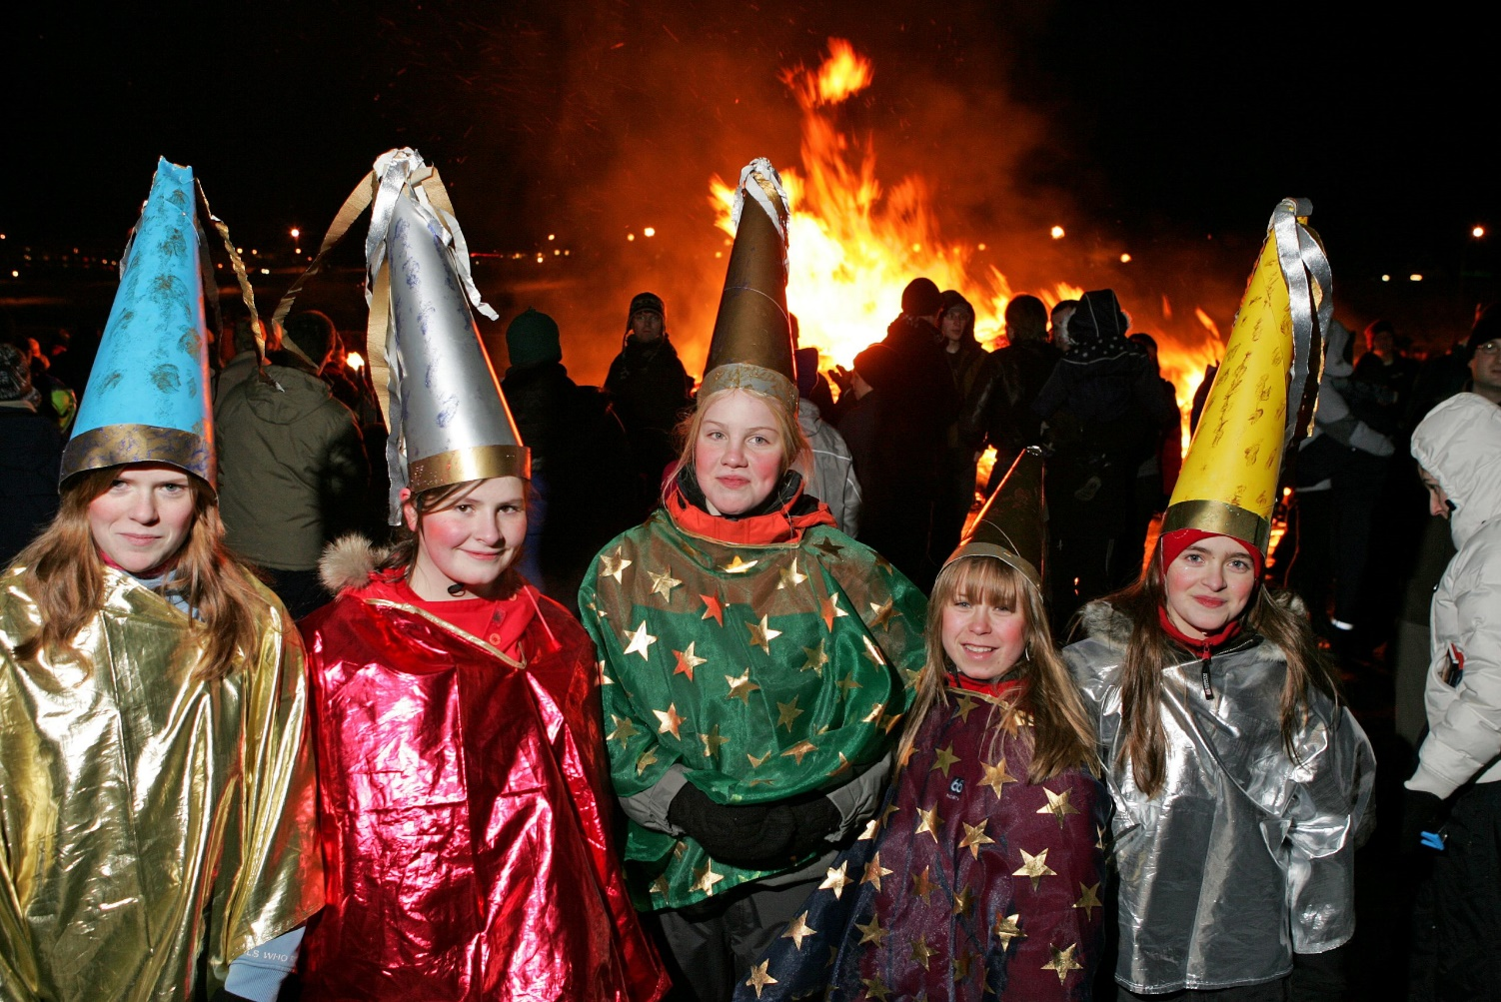
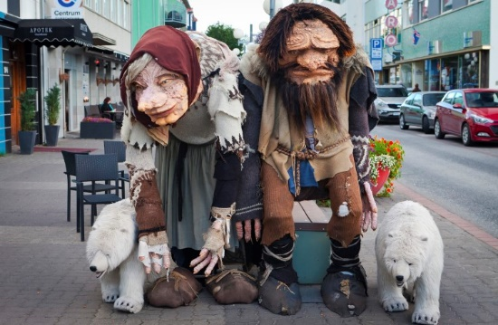
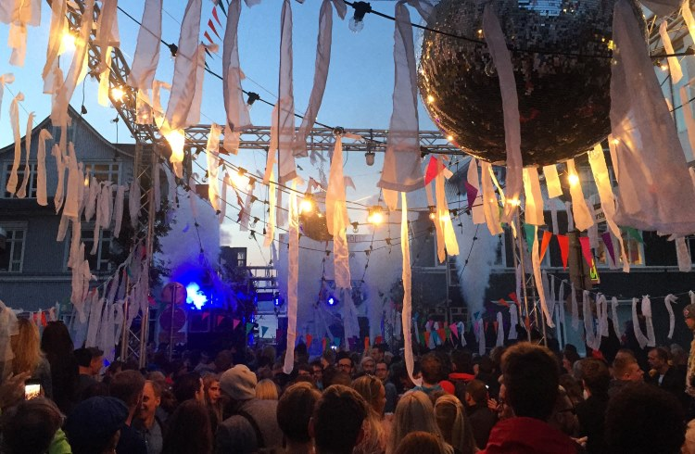
CULTURE
Icelanders have a strong culture of food, literature and the arts.

Slide 6

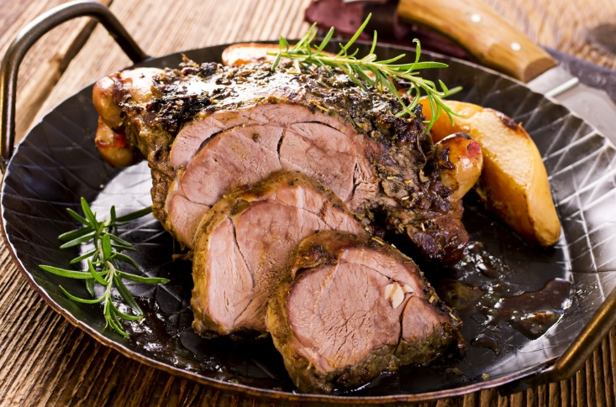
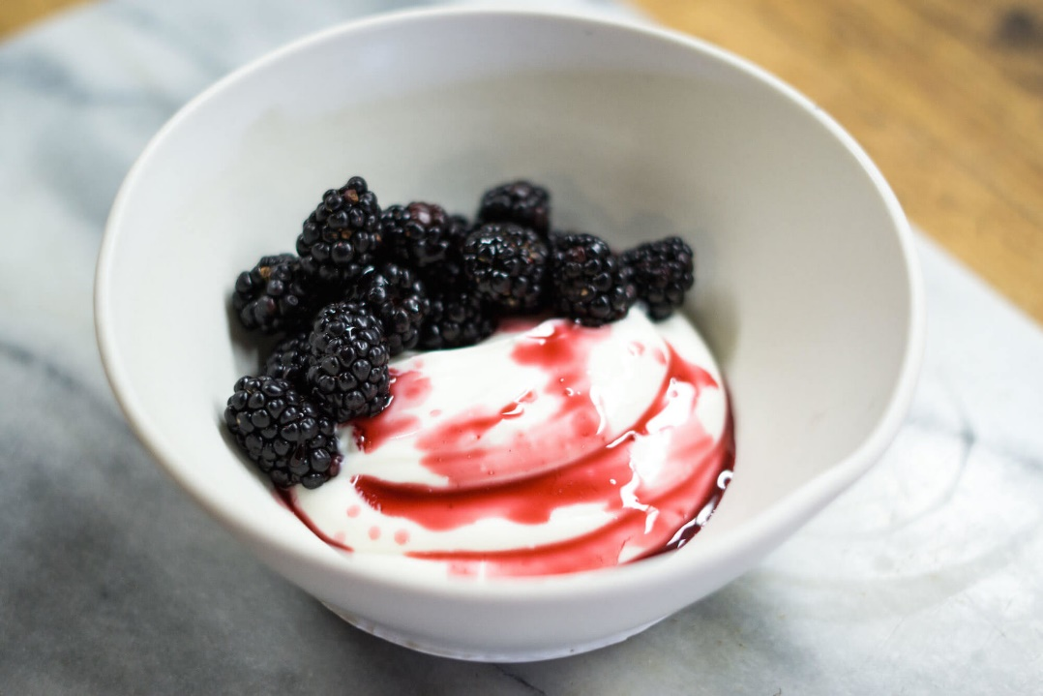
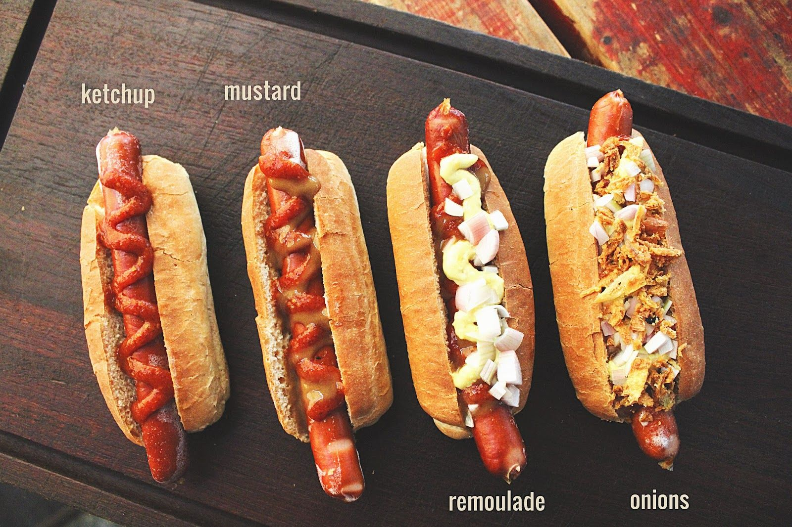
FOODS
10 BILLION
5 BILLION
Lamp
Skyr
Hot dogs

Slide 7
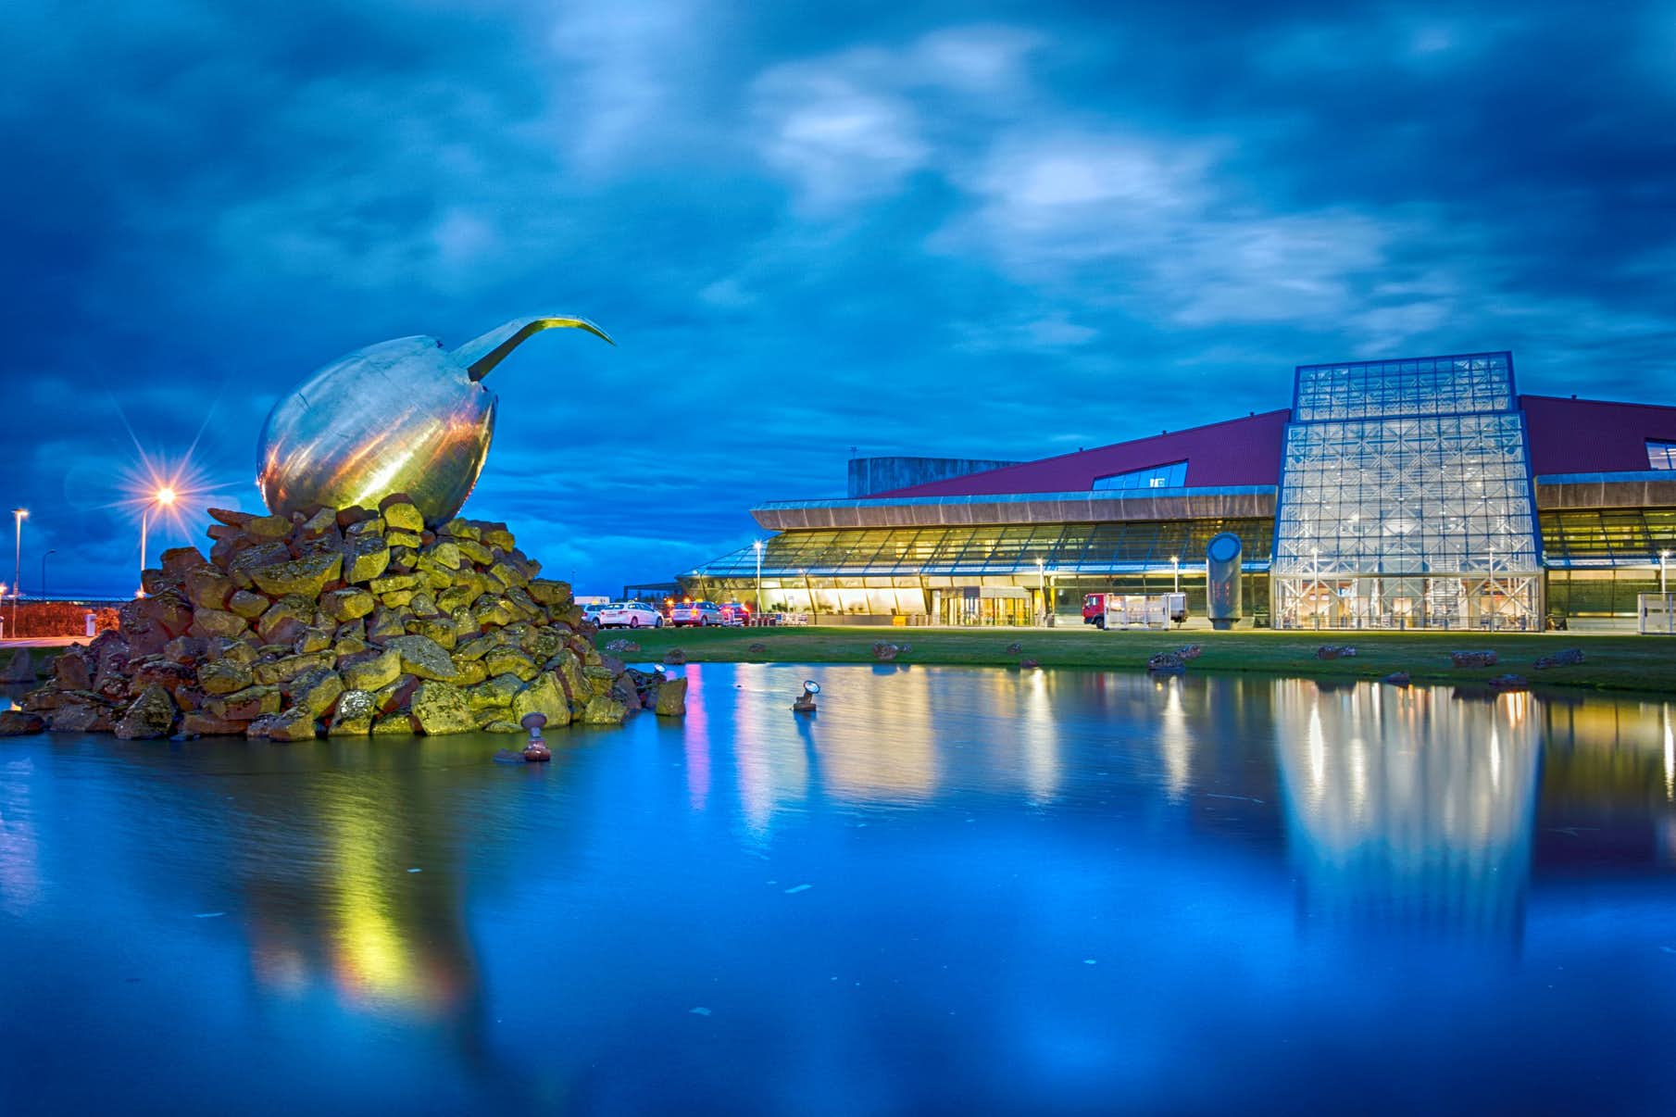
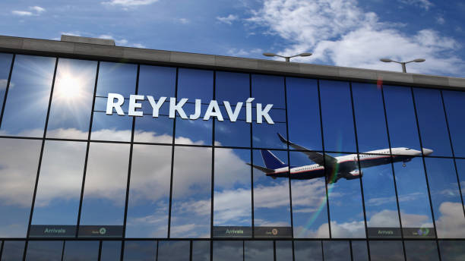
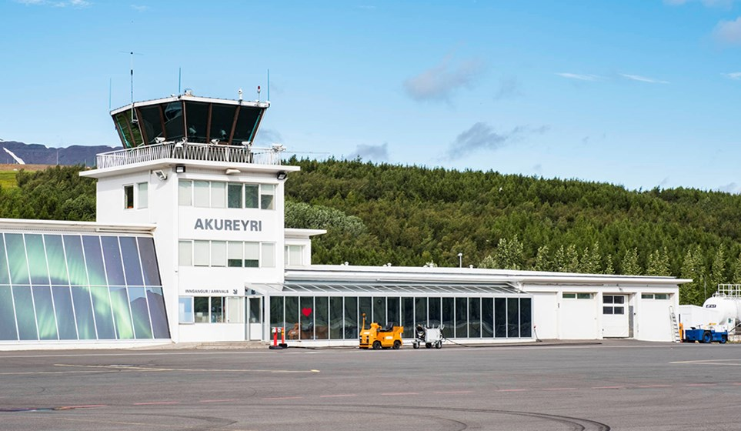
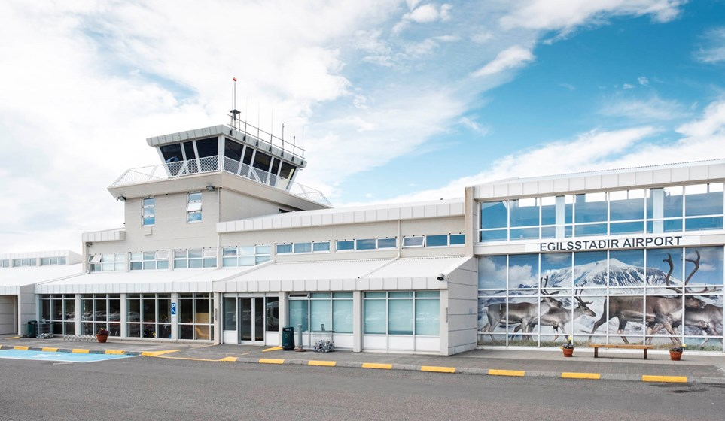
AIRPORT
In Iceland you can find 464 authorized airports
Four international Airport
Keflavik Airport
Reykjavik Airport
Akureyri Airport
Egilsstadir Airport
10 Billion
5 Billion

Slide 8
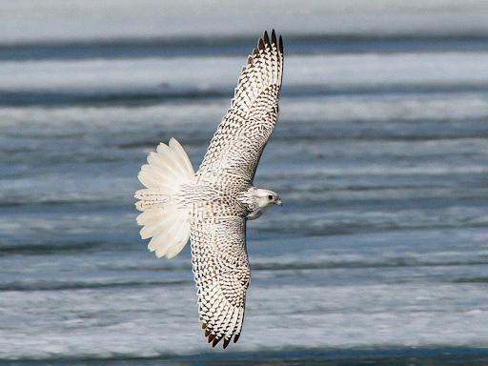
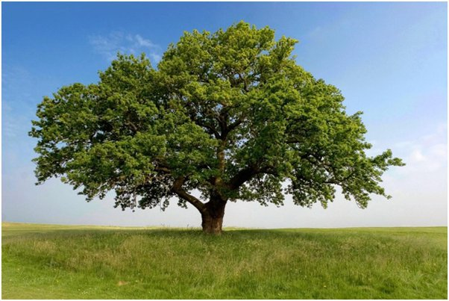
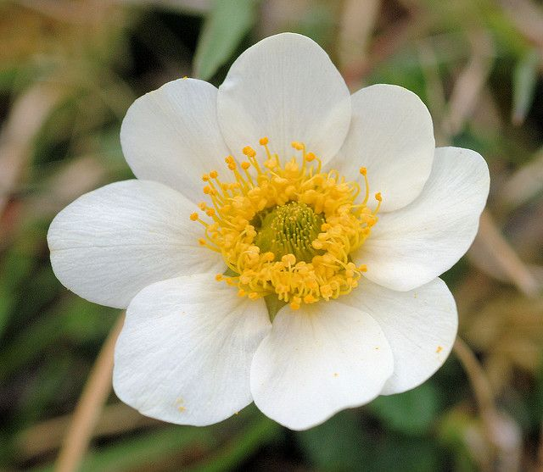
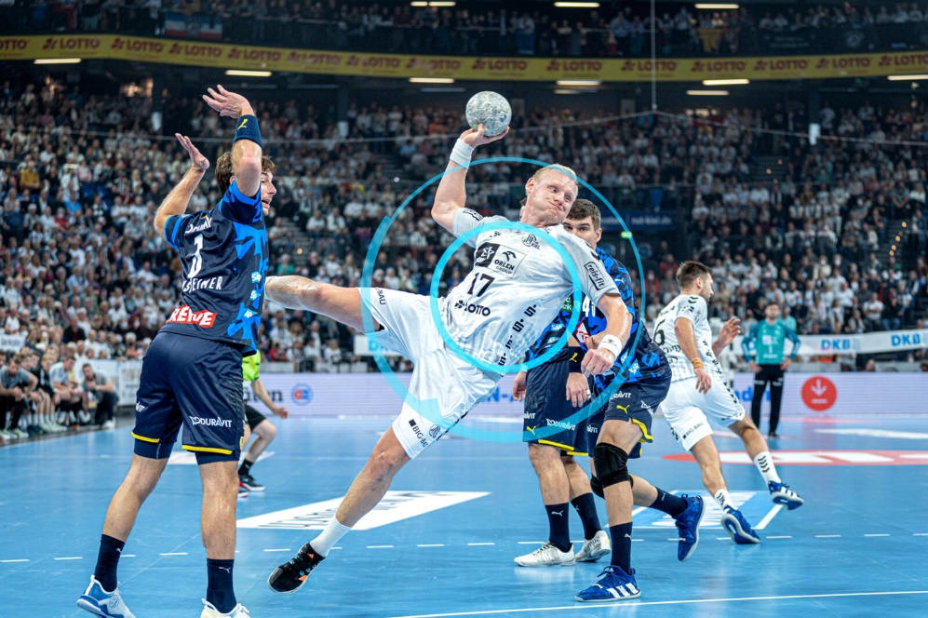

Nationals of Iceland
2023
2024
2025
Gyrfalcon
Downy brich tree
Mountain Avens
Hand Ball

Slide 9

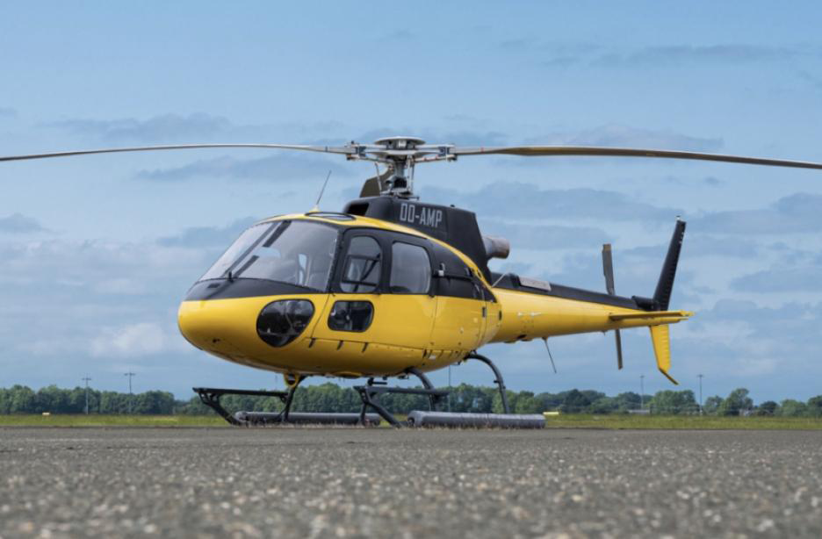
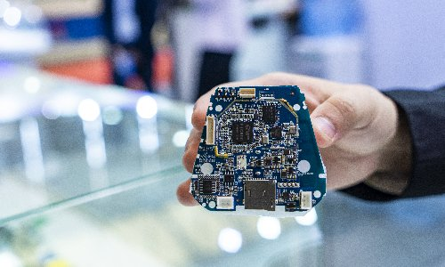
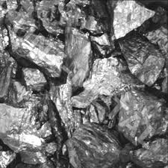
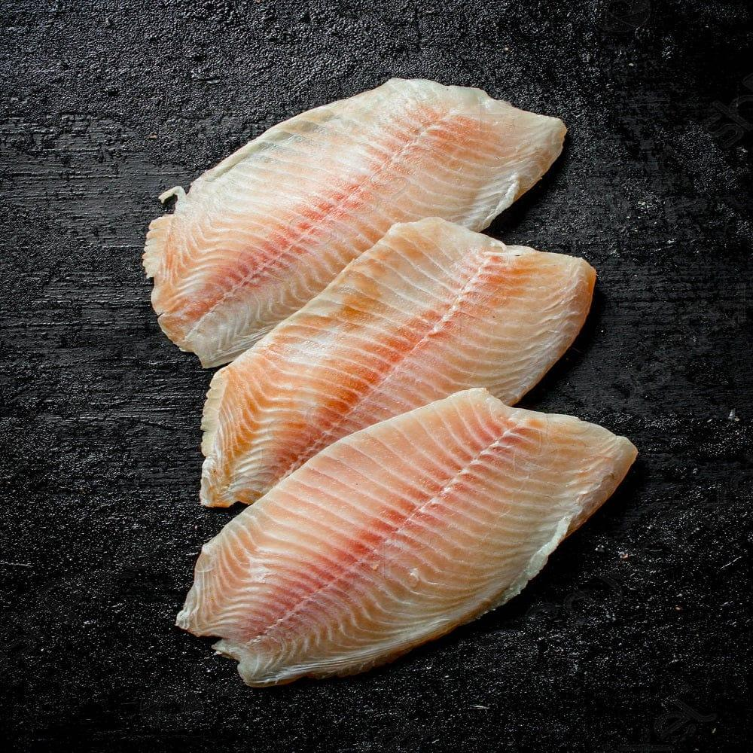
Import & Export
Helicopter
Corban Electronics
The total value of exports & Import (FOB) is US$ 5,974 million
Raw Aluminium
Fish Fillet

Slide 10

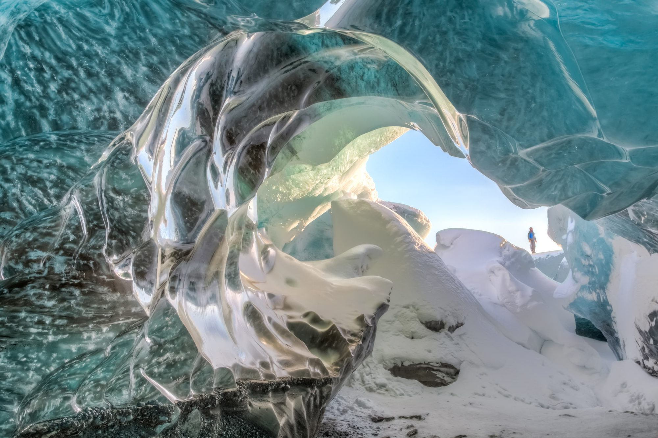
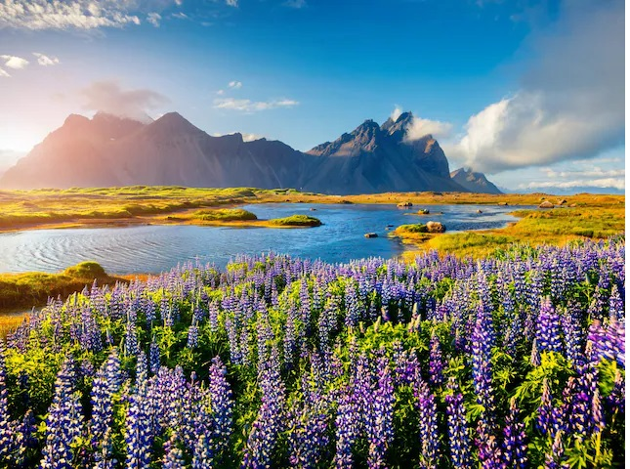



Tourist Place
Ice cave
Mindnight sun

Slide 11

Financial Guidance
Briefly elaborate on what you want to discuss.
*Rupee amounts are in millions
FY '25
₹ 000
FY '26
₹ 000
YOY change
Revenue
%
Expenses
Customise this table! Just right-click on any cell to see all the available table functions.
Profit
To merge, first highlight two or more cells, then click "Merge Cells" to organize your table according to your needs!
Dividend/share
Back to Agenda

